Slide 1

WELCOME

Slide 2
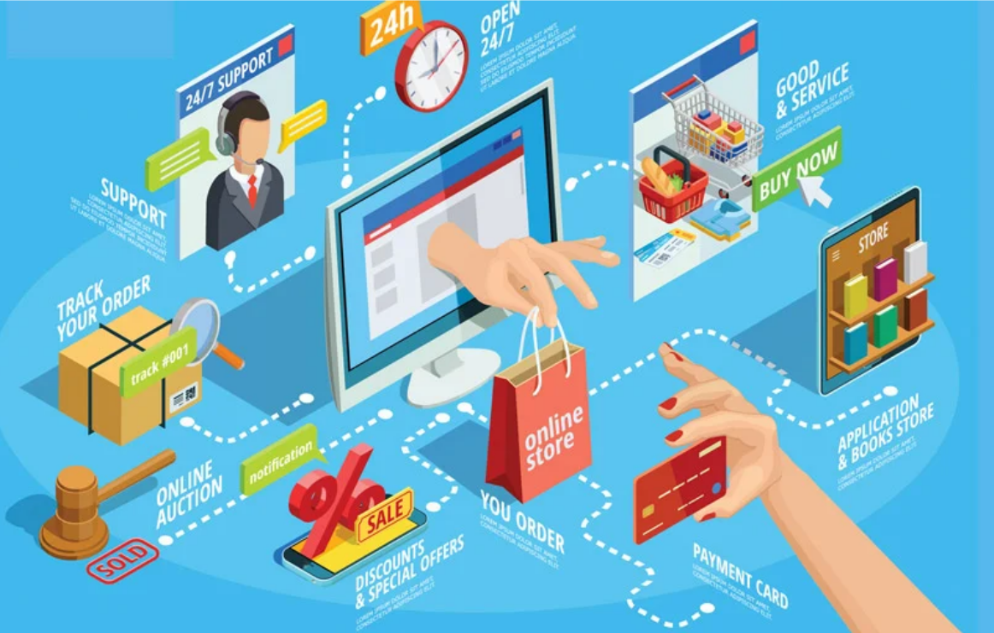

Slide 3

CREWMATES
PREM KUMAR.P (C)
MOHAMMED ABDUS SAMI.M
PARAMESH GOPAL.K.U
PANDI PERUMAL.P
VINOTH KANNAN.A
From
ECE Boys

Slide 4

LUFFY ONLINE MART
In this ppt we are going to explain about the online shopping portal made by our teammates for your day-to-day routine.
Our LUFFY ONLINE MART is slightly easier to use when compared to the other online shopping websites.
To make it easier we have included easy steps to place the order in our online portal.
We have a separate portal for the buyer and the seller. So that there will be no confusion while sign in or login to our portal.
Our website will be so handy to work or to use and you can trust us completely.

Slide 5

PORTAL FOR CUSTOMER
This is the portal were all the customer will be using .
This portal is public free portal.
This portal is a cookies free.
This will be convenient to use.
This will much more useful than other online portal.

Slide 6
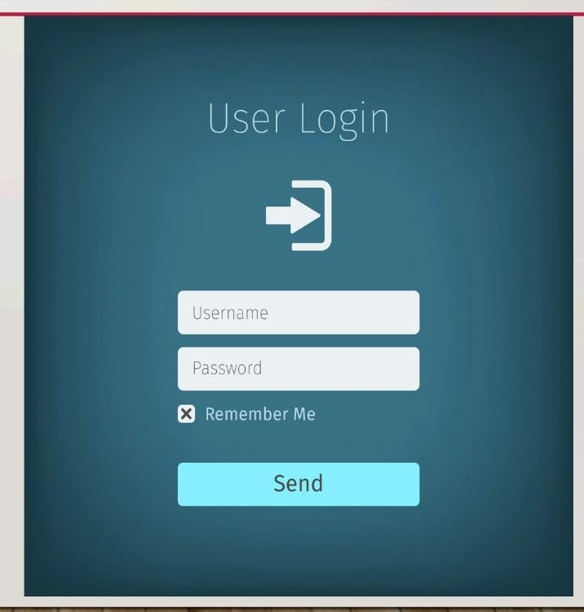
USER LOGIN
We are making the user to login in first. Once when they login to our online portal, they were free to use it without any disturbance.
They must create their own account for our online portal.
It will enchance them to use our online portal nice and easy.

Slide 7
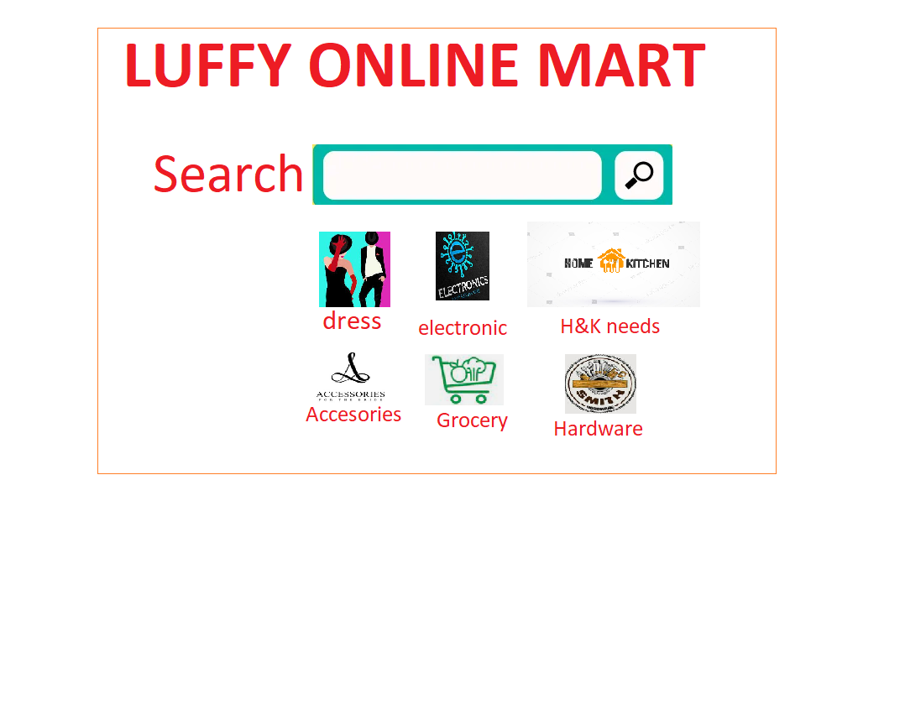
THINGS FOR SALE
We have almost what every person wanted in their day-to-day routine.
Starting from Grocery, Home & Kitchen needs, Accessories, Hardware, and even we have Electronics.
We facilitate our customer that we have every things in one online portal called LUFFY ONLINE MART.

Slide 8

PORTAL FOR SELLER
This portal will be much easier to control when compared to many other portal .
Our LUFFY ONLINE MART will never ever take any commission for the seller and the buyer.
We will make sure that the placement of order from the seller to the buyer is clear and correct .
So that there will be no confusion or miss understanding between both seller and the buyer.
Our LUFFY mart can be a trusted one for both the buyer and the seller.

Slide 9
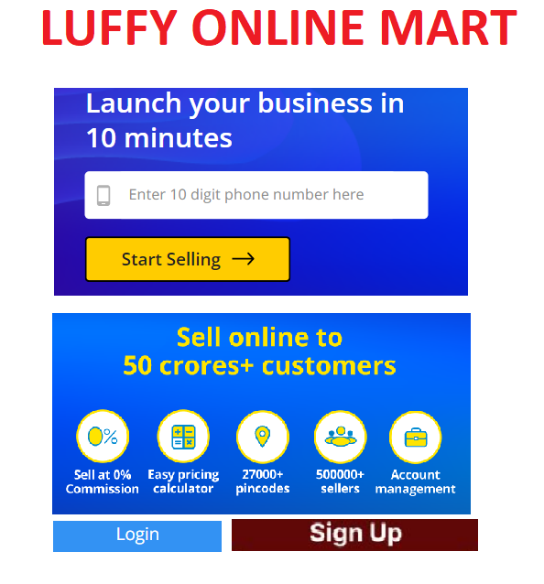
USER LOGIN
From here the seller can use our portal.
From this itself we can say that we give more opportunities to the seller to make their business to grow further .
Our LUFFY ONLINE MART will be so help full.

Slide 10


